Slide 1



Arrhythmic risk in gene elusive patients with DCM/NDLVC
Towards a personalized approach
ERN GUARD-Heart Webinar 16 Sept 2026: Genetics and arrhythmia in DCM/NDLVC
Sean J. Jurgens, MD MSc PhD
Assistant Professor of Cardiogenetics
Amsterdam UMC

Slide 2
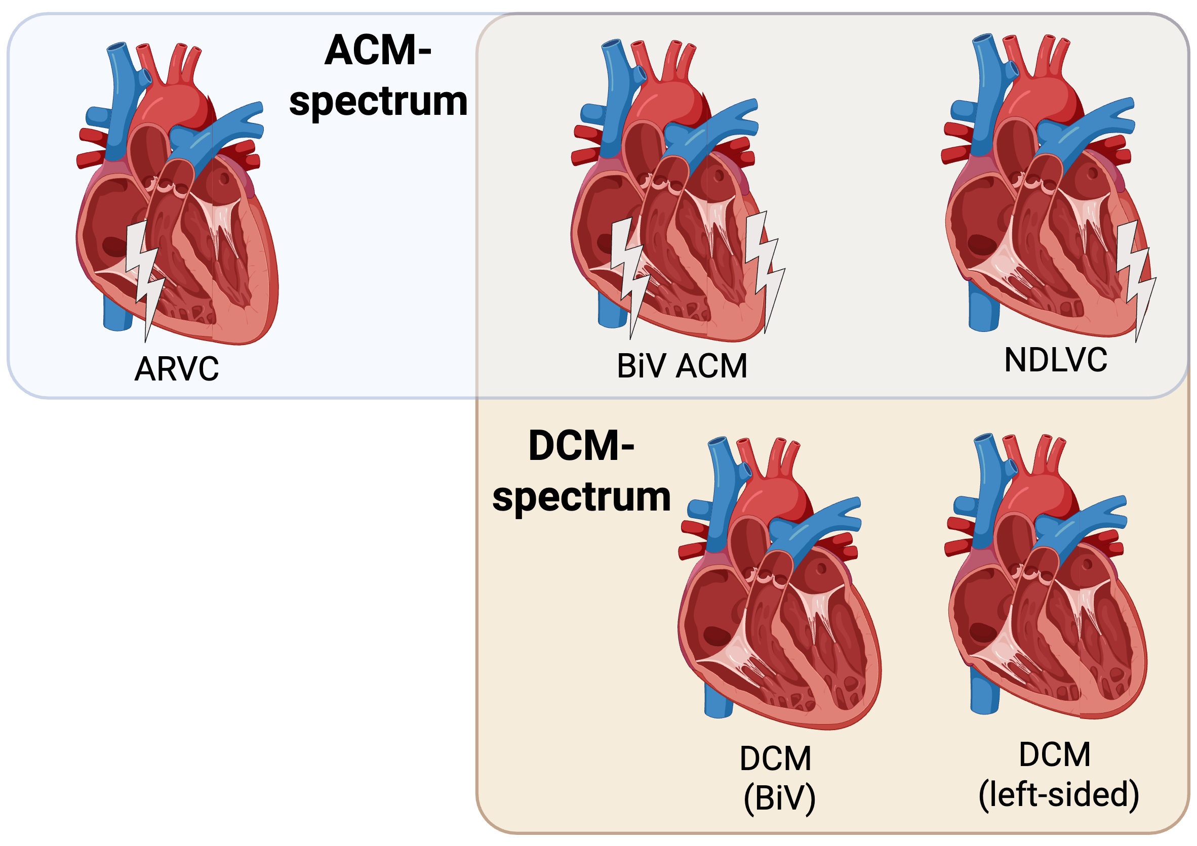
Geno-negative NICM: all about phenotype?
/ALVC
60-80%
Gene elusive!

Slide 3
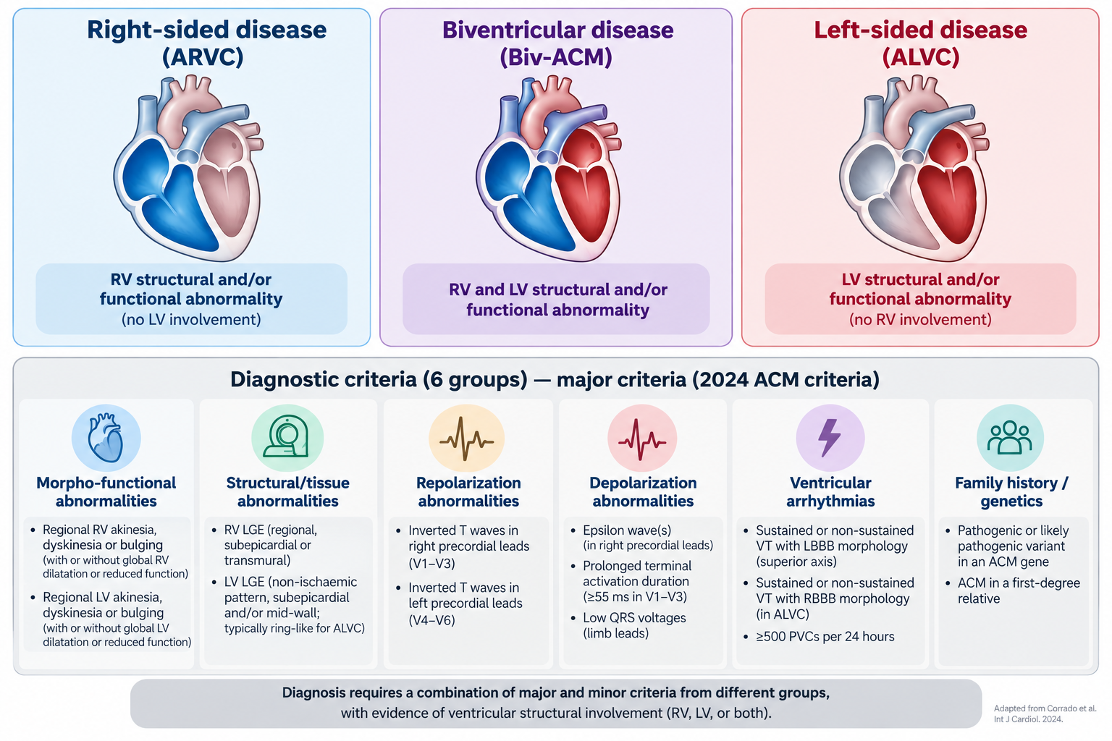
ACM: 2024 proposed criteria
Corrado et al. (2024). Int J Cardiol. 2024;395:131447.

Slide 4
Geno-negative NICM: all about phenotype
Definitions for NDLVC in literature are fuzzy!
/ALVC
For purpose of this talk:
ALVC = arrhythmogenic LV cardiomyopathy
suspected/definite TF criteria
NDLVC = non-dilated LV cardiomyopathy
LVEF<50% and/or LGE, possible ACM
HNDLVC = hypokinetic NDLVC
LVEF<50%, possible ACM

Slide 5
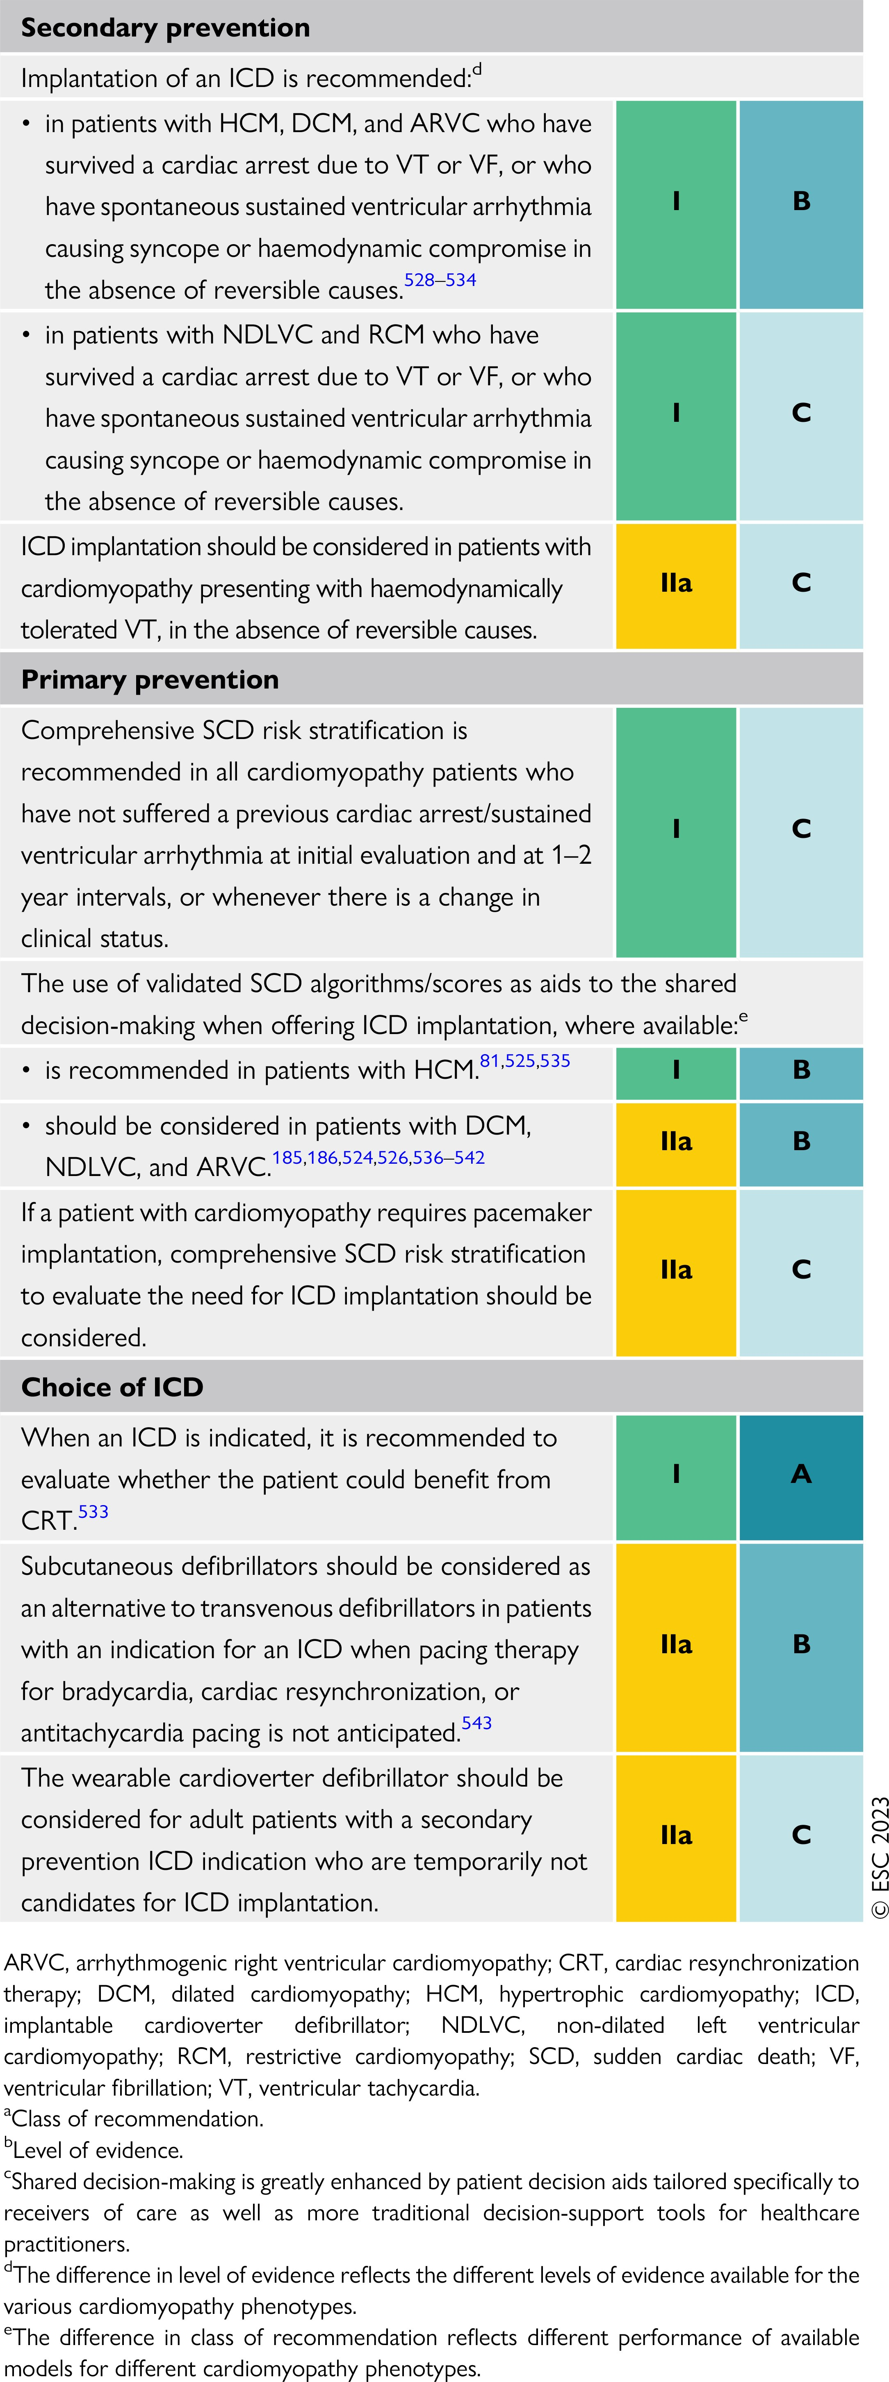
Guidelines: Secondary prevention in NICM
Established VT/VF → ICD recommendation
2023 ESC Guidelines for the management of cardiomyopathies

Slide 6
Primary prevention in NICM: historic
SCD/MVA stratification & ICD consideration
LVEF
<35%
w/ OMT

Slide 7
Guidelines: Primary prevention in NICM
Regular SCD risk assessments
2023 ESC Guidelines for the management of cardiomyopathies

Slide 8
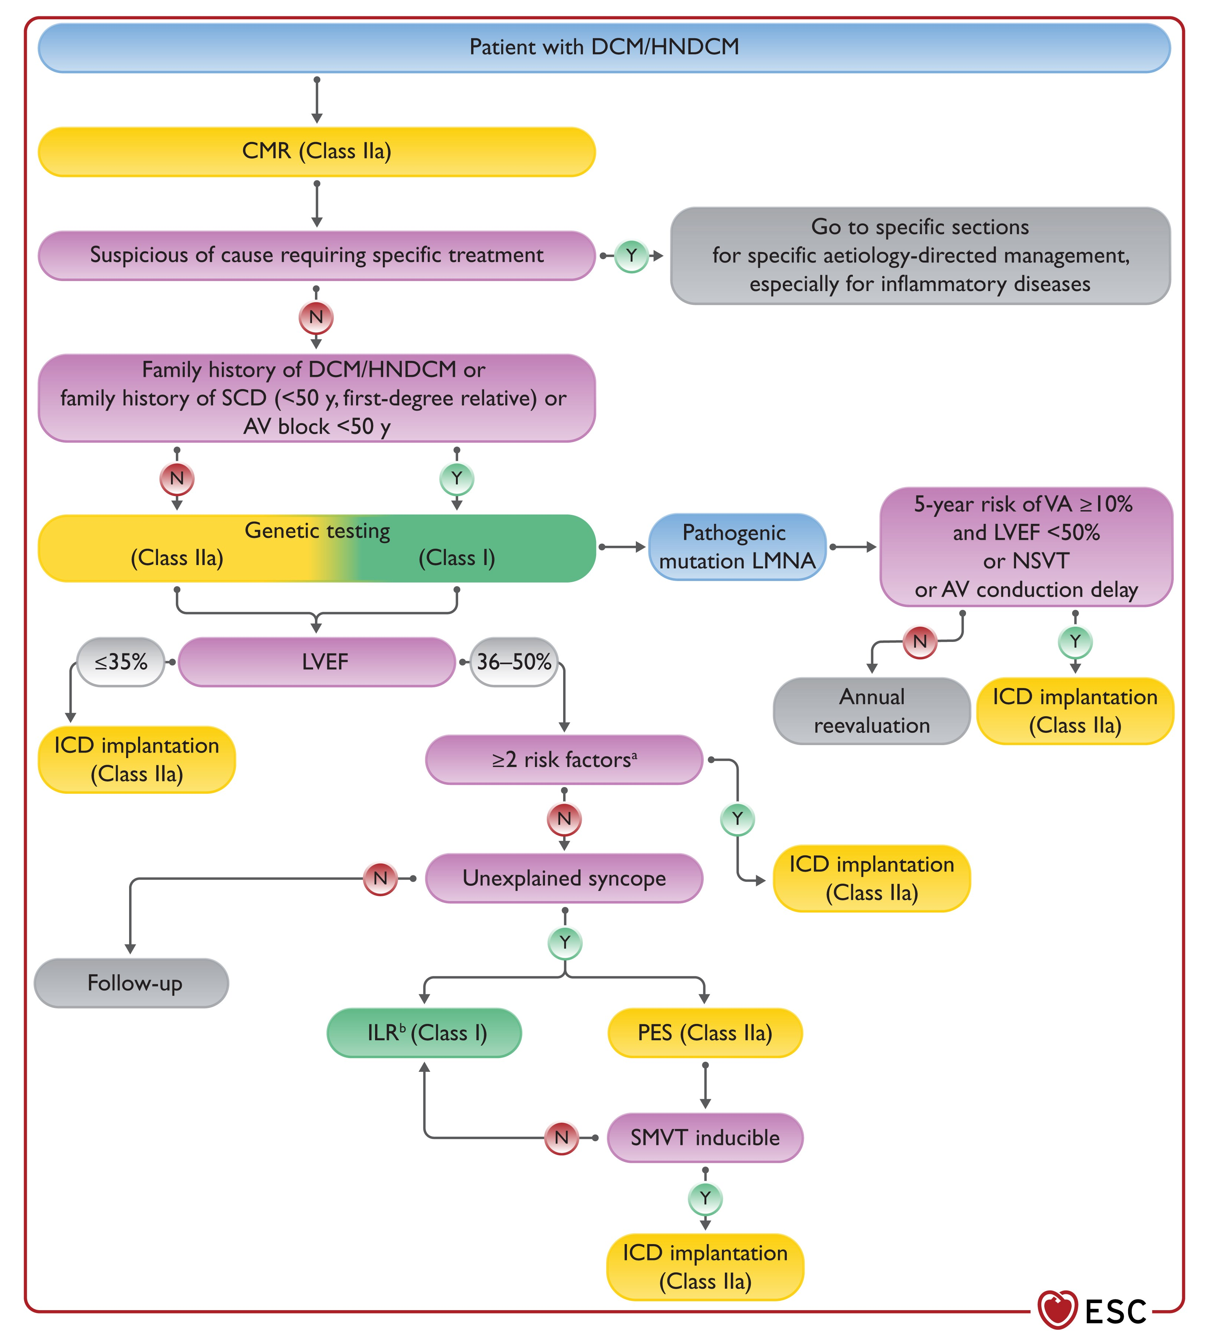
Guidelines: Primary prevention in DCM/NDLVC
Consider phenocopies!
2022 ESC Guidelines for the management of patients with ventricular arrhythmias and the prevention of sudden cardiac death

Slide 9
Guidelines: Primary prevention in DCM/NDLVC
2022 ESC Guidelines for the management of patients with ventricular arrhythmias and the prevention of sudden cardiac death

Slide 10
Primary prevention in NICM: guidelines
LVEF
35-49%
w/ OMT
LMNA P/LP variant
Induc. VT on PES
SCD/MVA stratification & ICD consideration
LVEF
<35%
w/ OMT
Other risk gene P/LP variant
LGE on cMR
Sucp. TLOC
NSVT, PVC burden
Family history SCD
2023 ESC Guidelines for the management of cardiomyopathies
Many risk factors: ICD consideration even in normal EF

Slide 11
Primary prevention in NICM: guidelines
LVEF
35-49%
w/ OMT
LMNA P/LP variant
Induc. VT on PES
SCD/MVA stratification & ICD consideration
LVEF
<35%
w/ OMT
Other risk gene P/LP variant
LGE on cMR
Sucp. TLOC
NSVT, PVC burden
Family history SCD

Slide 12
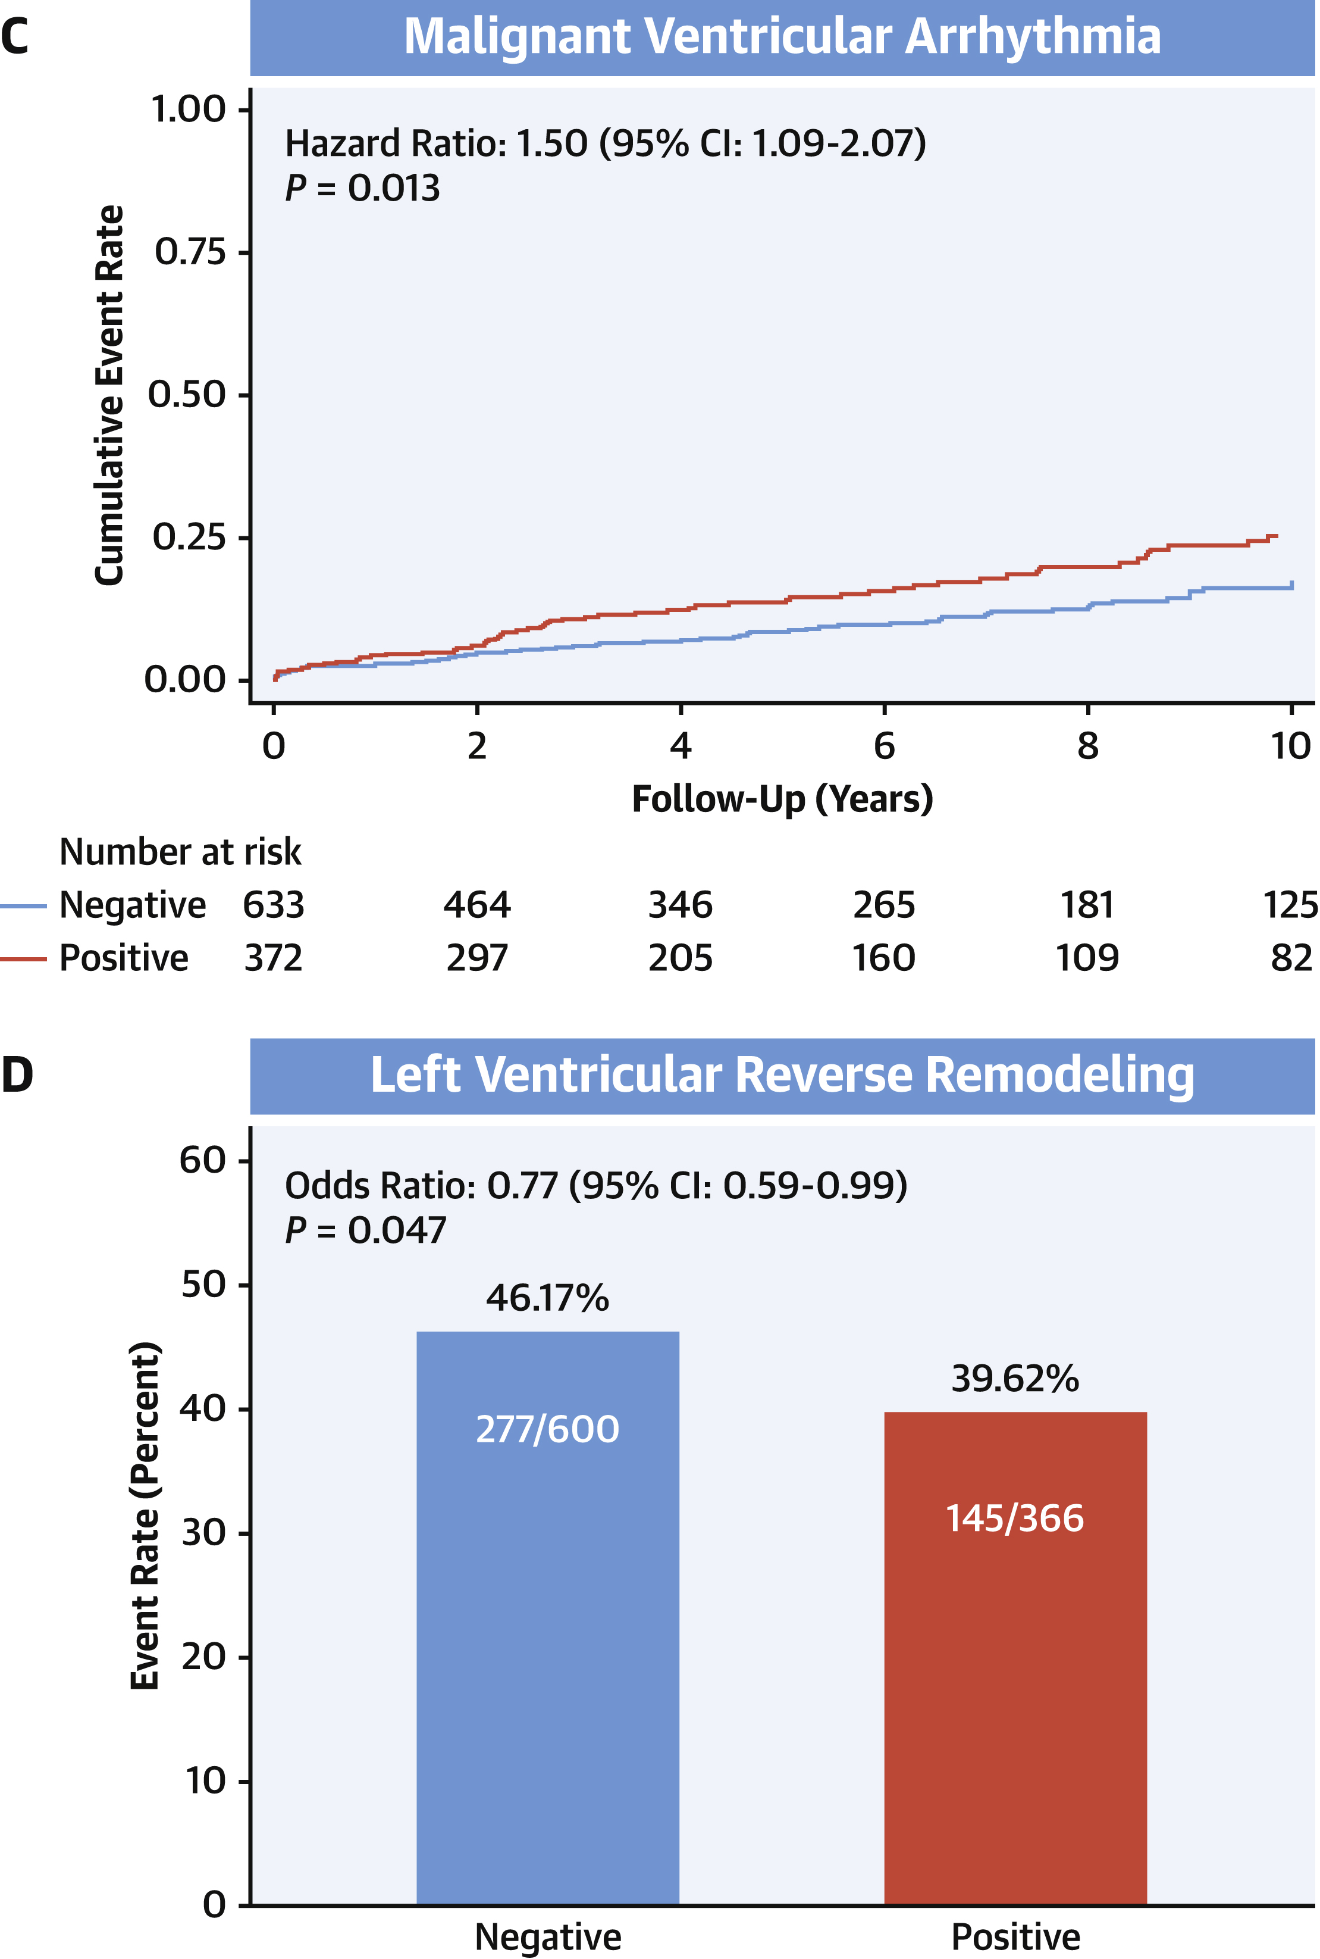
Arrhythmic risk in gene elusive DCM
N=1,005 DCM patients; retrospective enrolment; 20 centers
5-year MVA risk: ~8%
MVA in geno- NDLVC unclear
Escobar-Lopez et al. JACC. 2021;78:1682–1699

Slide 13
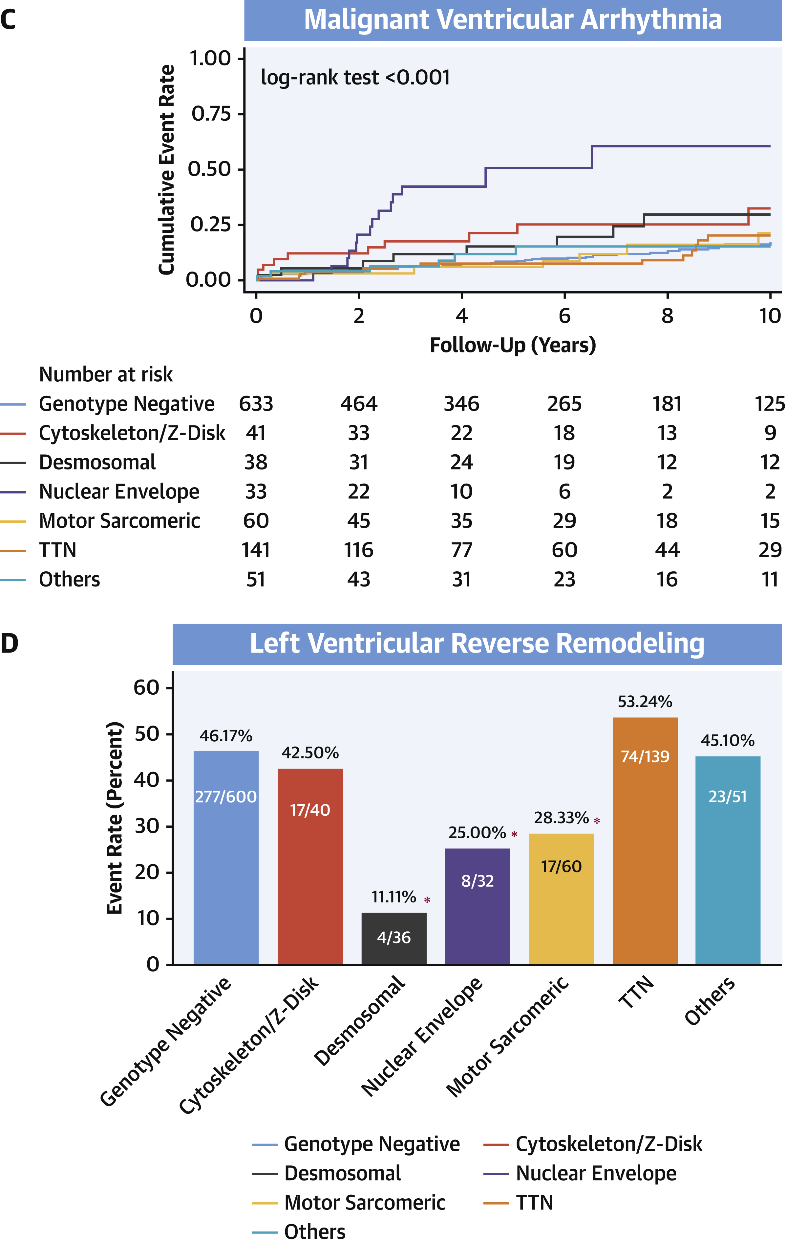
Arrhythmic risk in gene elusive DCM
N=1,005 DCM patients; retrospective enrolment; 20 centers
~8% 5-year MVA risk
~46% reverse remodelling
MVA in geno- NDLVC unclear
Escobar-Lopez et al. JACC. 2021;78:1682–1699

Slide 14
Primary prevention in DCM/NDLVC
LVEF
35-49%
w/ OMT
LMNA P/LP variant
Induc. VT on PES
SCD/MVA stratification & ICD consideration
LVEF
<35%
w/ OMT
Other risk gene P/LP variant
LGE on cMR
Sucp. TLOC
NSVT, PVC burden
Family history SCD

Slide 15
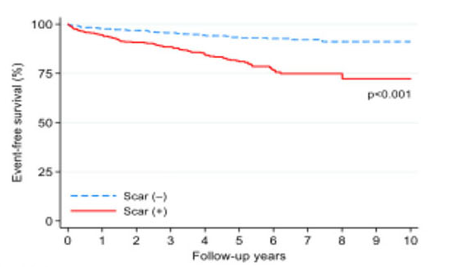
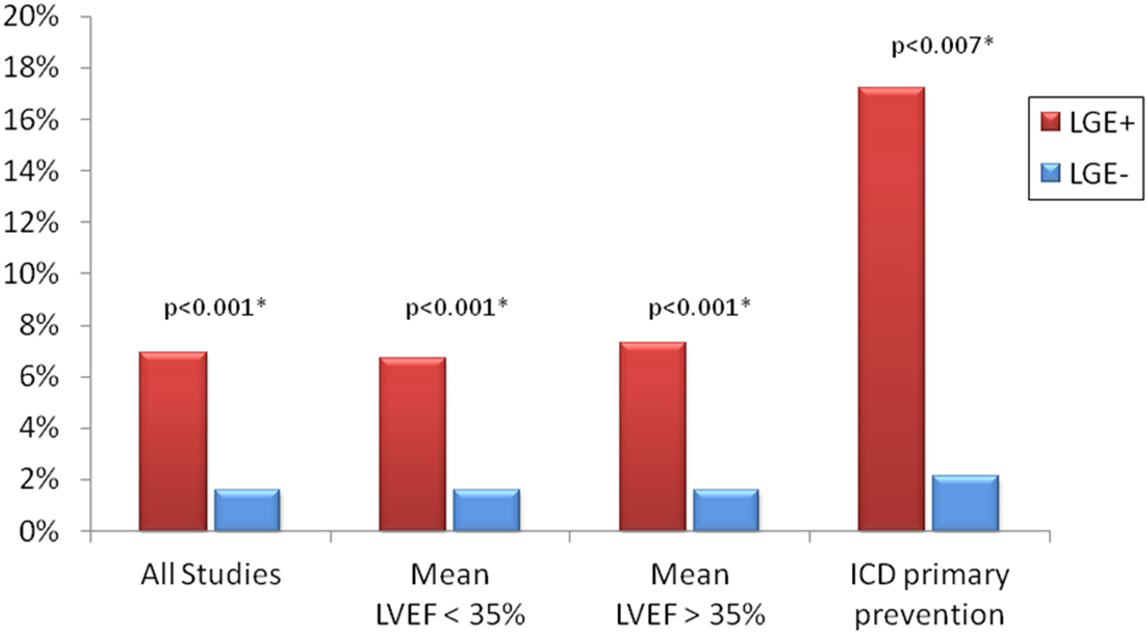
LGE and arrhythmia in DCM/NDLVC
N=1,020 DCM/HNDLVC; prospective; 3 US centers
N=2,948 DCM patients; meta-analysis; N=29 studies
Malignant arrhythmic events
Annual malignant arrhythmia rate
LGE scar -
LGE scar +
HR=~4-7
Klem et al. Circulation. 2021;143:1343–1358.
Di Marco et al. JACC. 2021;77:2890–2905.
Notes:
Klem: LGE is 2SD above mean LG signal for region.
Also assessed %LV mass affected, some association between extent, although non-linear (most risk increase at low LGE!)
Notably, here scar predicted MORE than low LVEF!!
Di Marco: manty different definitions.
Notably, no association between extent and outcomes.

Slide 16
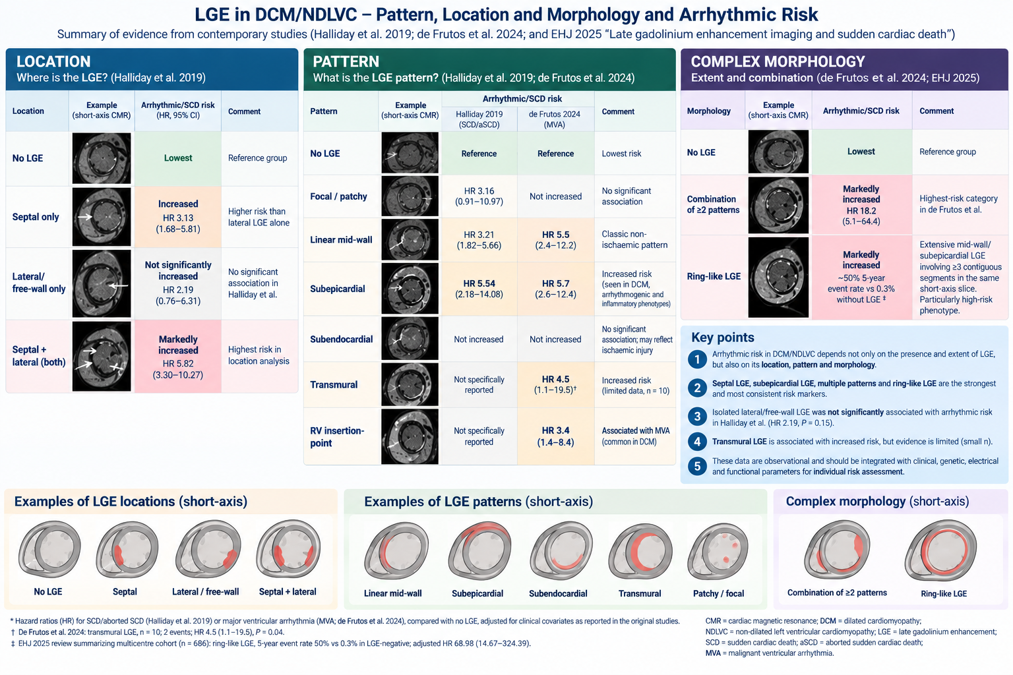
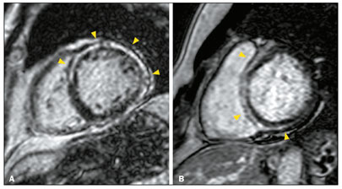
LGE patterns in DCM/NDLVC
Local pattern
Location
Complexity
Halliday 2019
De Frutos 2024
Halliday 2019
De Frutos 2024
Lineal mid-wall
Halliday et al. (2019) JACC CI. 12:1645–1655: N=874 DCM, prospective
De Frutos et al. (2024) EHJ CI 25:75–85: N=577 DCM/HNDLVC, retrospective

Slide 17
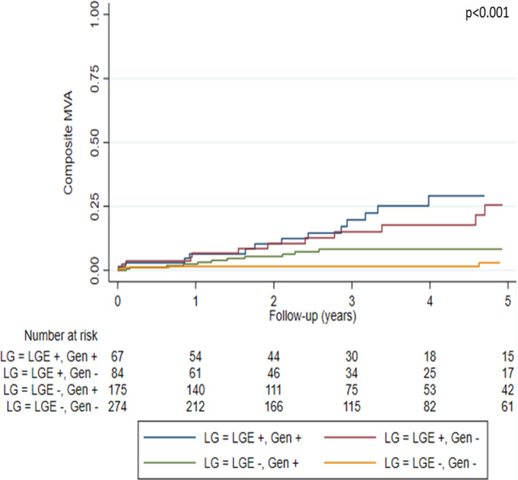
LGE in geno-negative DCM
N=600 DCM; retrospective; 20 Spanish centers
LGE presence+pattern important for MVA risk!
LGE in geno-negative:
~24%
MVA Risk:
HR 7.8 [3.2–19], in LGE+/G+
HR 7.3 [3.0–18], in LGE+/G-
Mirelis et al. (2022). EJHF. 22;24(7):1183–1196
Notes:
LGE = Any visually convincing LE by experts.
Although they also assessed extent, above figures are based on ANY LGE vs rest

Slide 18
Primary prevention in DCM/NDLVC
LVEF
35-49%
w/ OMT
LMNA P/LP variant
Induc. VT on PES
SCD/MVA stratification & ICD consideration
LVEF
<35%
w/ OMT
Other risk gene P/LP variant
LGE on cMR
Combined risk models
Sucp. TLOC
NSVT, PVC burden
Family history SCD

Slide 19
Guidelines: Primary prevention in NICM
2023 ESC Guidelines for the management of cardiomyopathies
Prospective data for most risk calculators lacking
2022 ESC Guidelines for the management of patients with ventricular arrhythmias and the prevention of sudden cardiac death

Slide 20
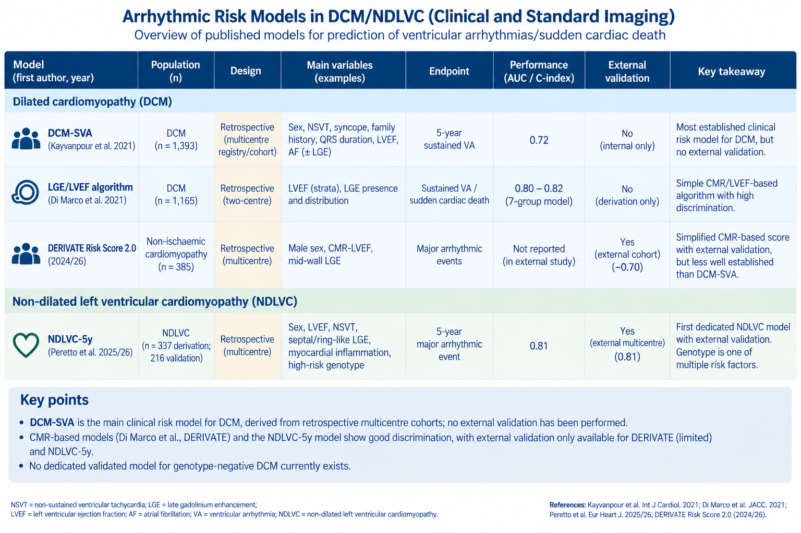
Risk models in DCM
Kayvanpour et al. Int J Cardiol. 2021;339:75–82
Di Marco et al. JACC. 2021;77(23):2890–2905
Guaricci et al. EHJ CI. 2025;26:1609–1619

Slide 21

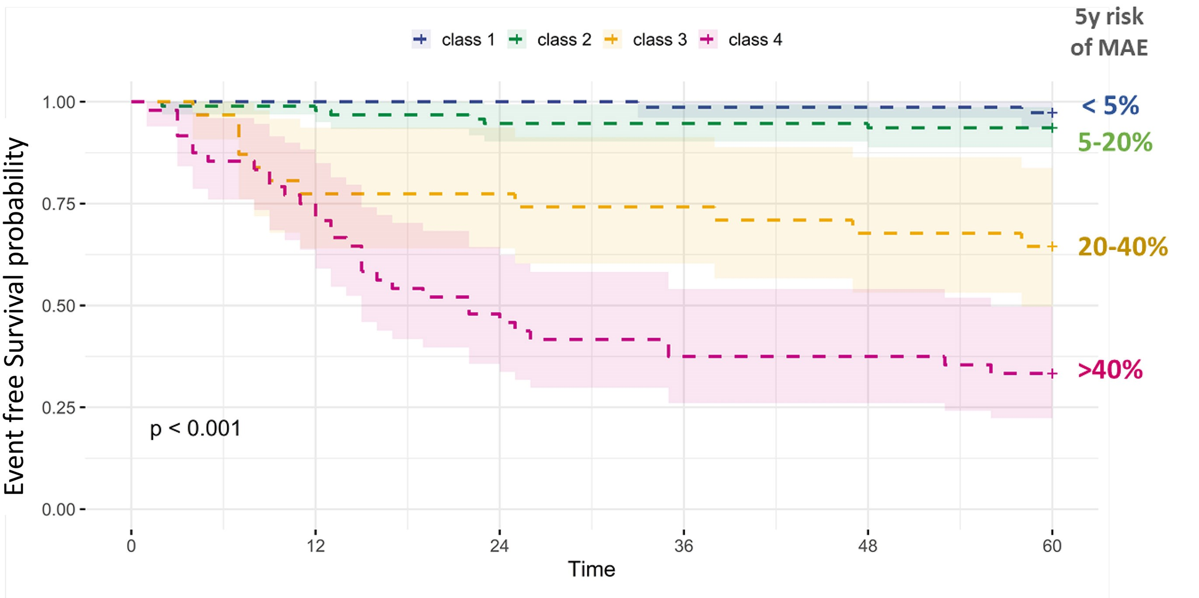
Risk models in NDLVC
Prospective data lacking. Stratified geno-negative data lacking.
Peretto et al. Eur Heart J. 2026;47(1):94–106.

Slide 22
Primary prevention in DCM/NDLVC
LVEF
35-49%
w/ OMT
LMNA P/LP variant
Induc. VT on PES
SCD/MVA stratification & ICD consideration
LVEF
<35%
w/ OMT
Other risk gene P/LP variant
LGE on cMR
Artificial intelligence
Sucp. TLOC
NSVT, PVC burden
Family history SCD

Slide 23
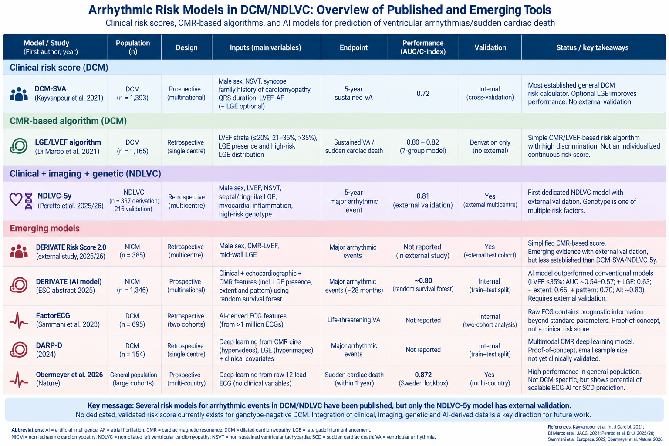
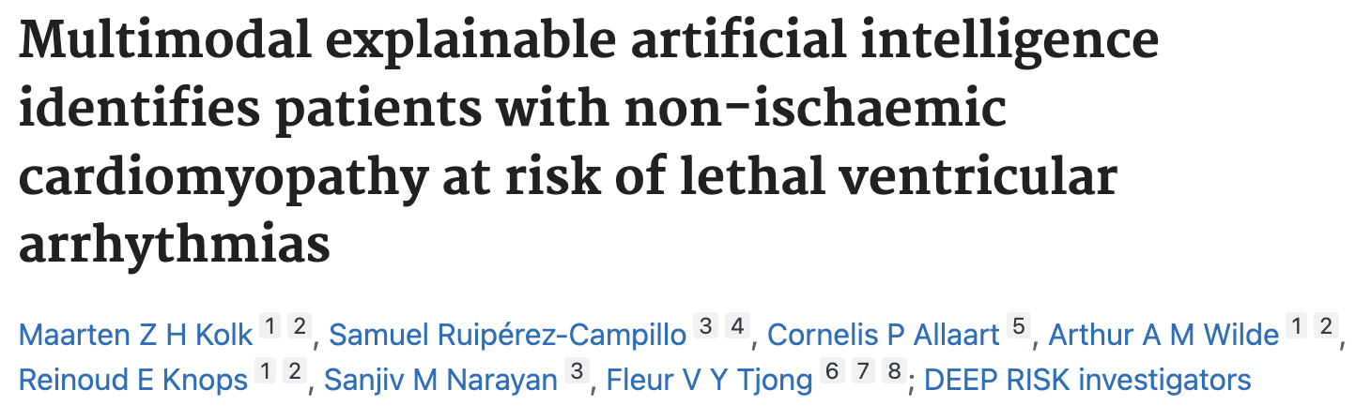
Future direction: AI-based classifier
Multimodal
Retrospective
N=288, DCM+ICD cohort
AUC ~ 0.84

Slide 24
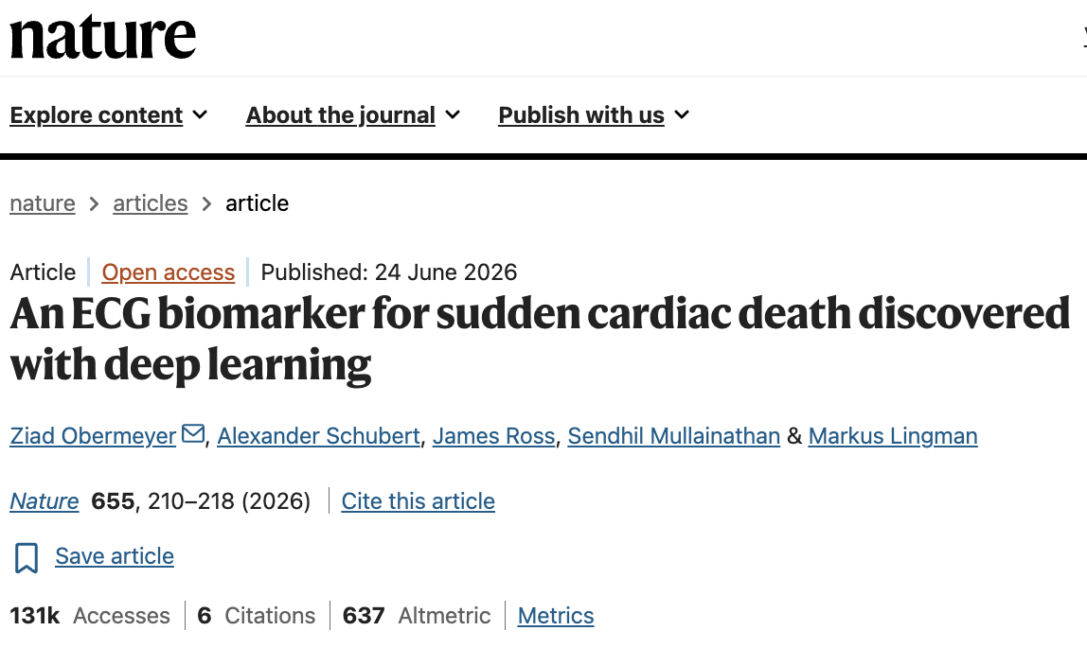
Future direction: AI-based classifier
Deep learning model for SCD
Not for DCM

Slide 25
Future direction: AI-based classifier
75% training, 25% testing
clinical + several MRI parameters
AI-models improve VA pred in DCM in future?
LVEF≤35% → AUC ~ 0.57
LGE presence → AUC ~ 0.63
LGE extent → AUC ~ 0.66
LGE pattern → AUC ~ 0.70
Random survival forest → AUC ~ 0.80
Still abstract only
ABSTRACT: DERIVATE Registry Investigators. Eur Heart J. 2025;46(Suppl 1):ehaf784.4371

Slide 26
Primary prevention in DCM/NDLVC
LVEF
35-49%
w/ OMT
LMNA P/LP variant
Induc. VT on PES
SCD/MVA stratification & ICD consideration
LVEF
<35%
w/ OMT
Other risk gene P/LP variant
LGE on cMR
Sucp. TLOC
Involved
RV?
NSVT, PVC burden
Family history SCD

Slide 27
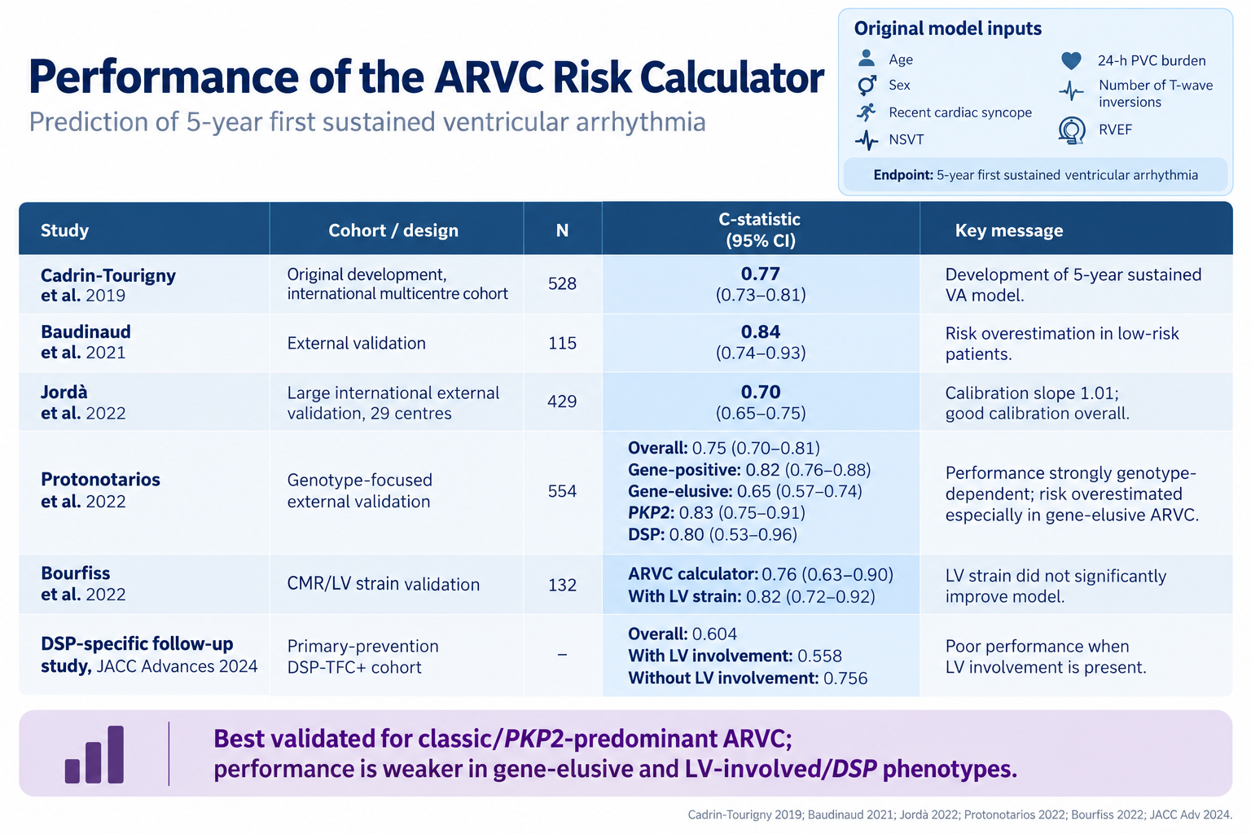
ARVC risk calculator
ARVC-RC less informative in geno-negative!
Cadrin-Tourigny et al. Eur Heart J. 2019;40(23):1850–1858.
Protonotarios et al. Eur Heart J. 2022;43:3053–3067.

Slide 28
Primary prevention in DCM/NDLVC
LVEF
35-49%
w/ OMT
LMNA P/LP variant
Induc. VT on PES
SCD/MVA stratification & ICD consideration
LVEF
<35%
w/ OMT
Other risk gene P/LP variant
LGE on cMR
Sucp. TLOC
Involved
RV?
NSVT, PVC burden
Family history SCD

Slide 29
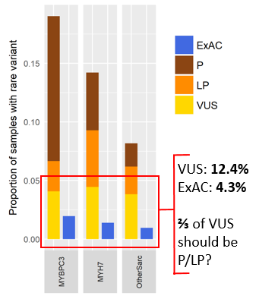
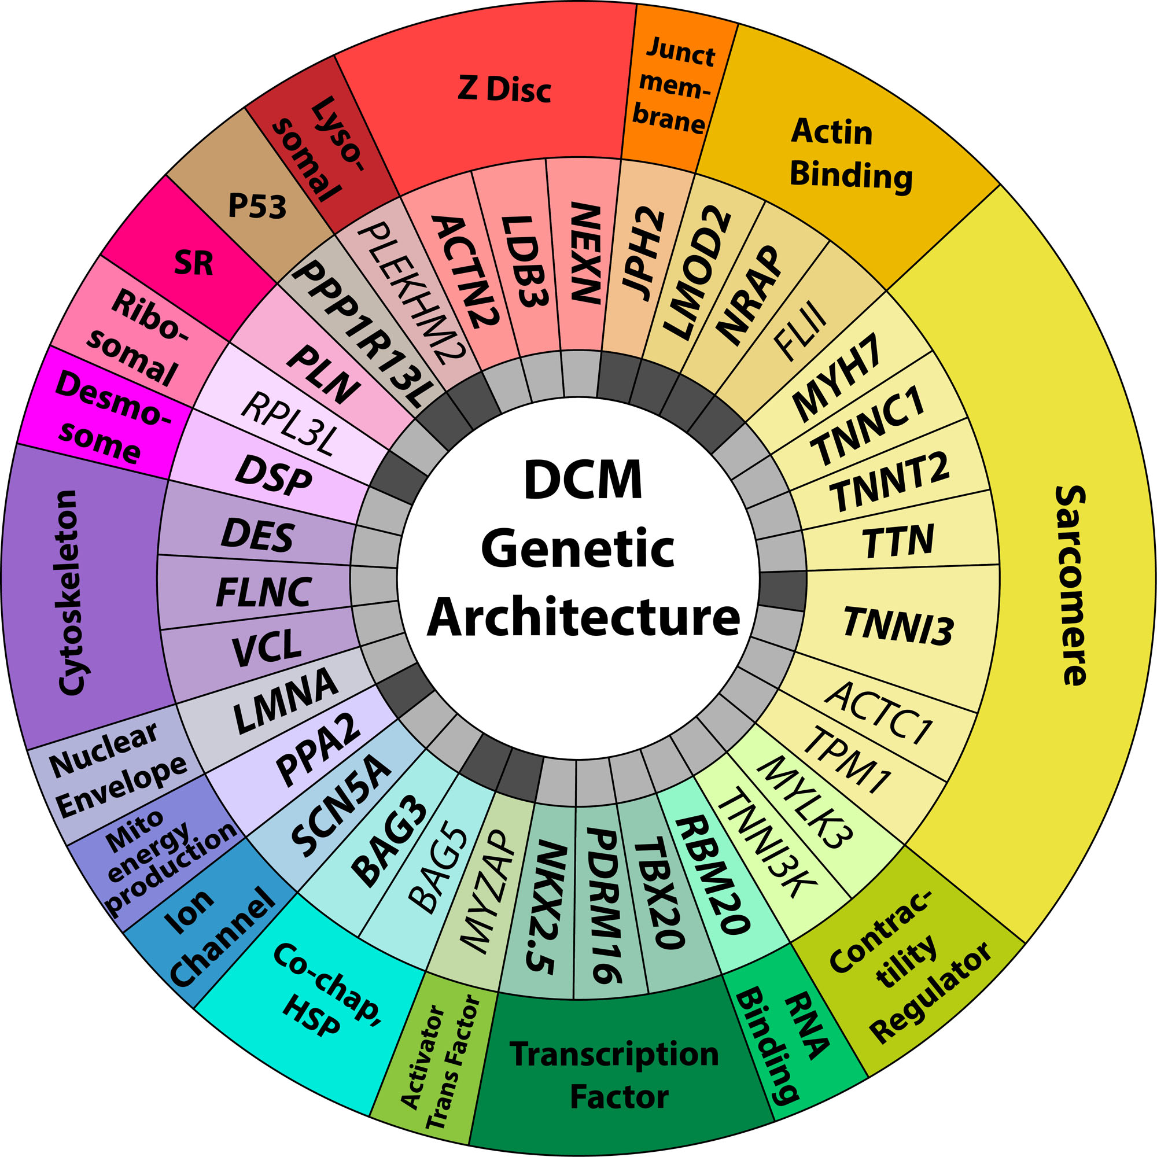
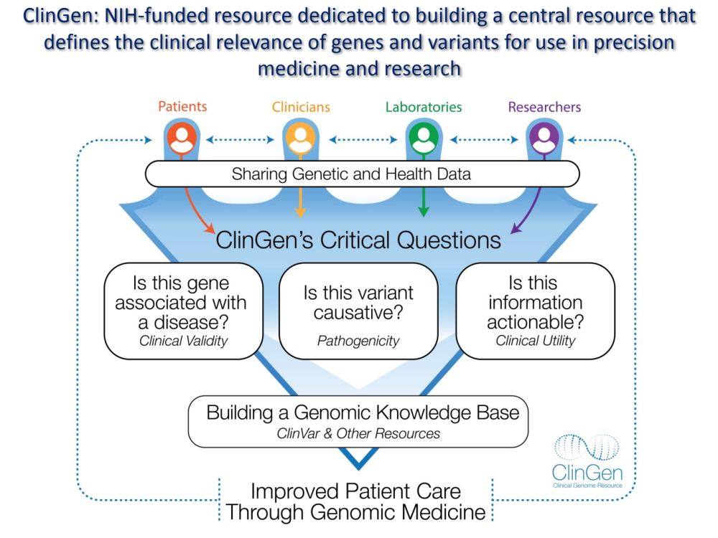
Pathogenic: variant curation is imperfect
Geno-negative need genetics re-evaluation!
19 higher-confidence genes in 2021
→ 35 higher-confidence genes in 2026!
Walsh et al. Genet Med. 2017;19(2):192–203
Jordan et al. Circulation. 2026. doi:10.1161/CIRCULATIONAHA.126.080302

Slide 30
Primary prevention in DCM/NDLVC
Other genetic factors?
LVEF
35-49%
w/ OMT
LMNA P/LP variant
Induc. VT on PES
SCD/MVA stratification & ICD consideration
LVEF
<35%
w/ OMT
Other risk gene P/LP variant
LGE on cMR
Sucp. TLOC
Involved
RV?
NSVT, PVC burden
Family history SCD

Slide 31
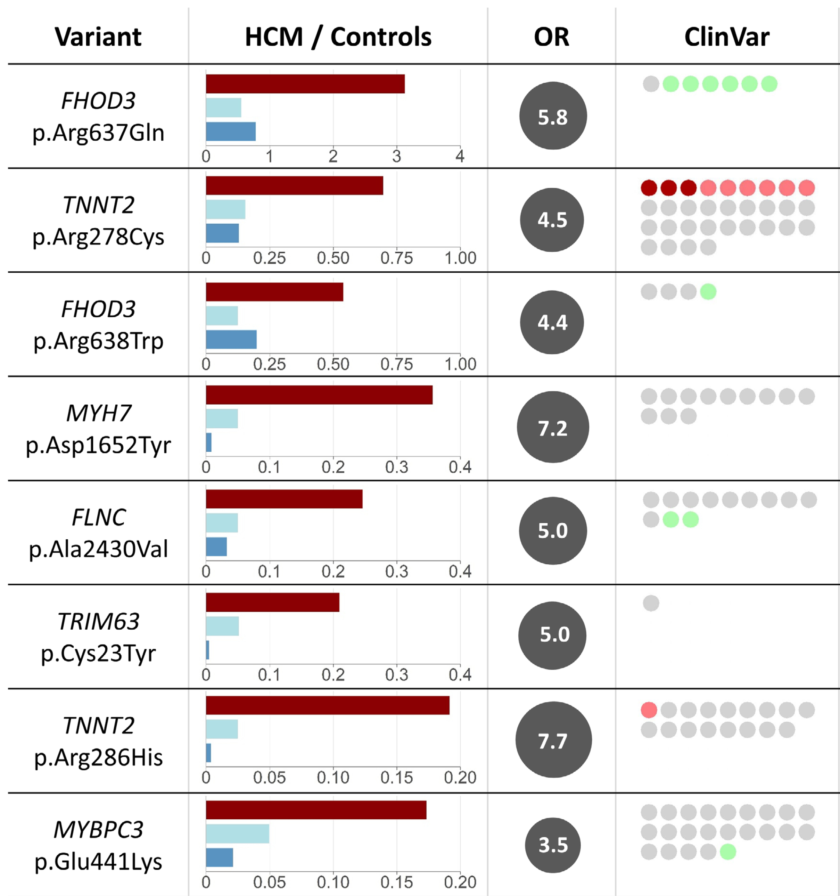
Genetic modifiers: intermediate effect variants
Previously determined ‘benign’
Previously mostly VUS, sometimes LP
→ Variants with intermediate frequency and effect, not fitting in clinical variant classifications
García Hernandez et al. Circulation. 2025;152:1060–1075.

Slide 32




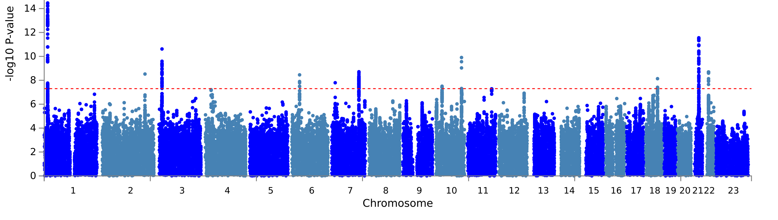
Genetic modifiers: GWAS

Slide 33
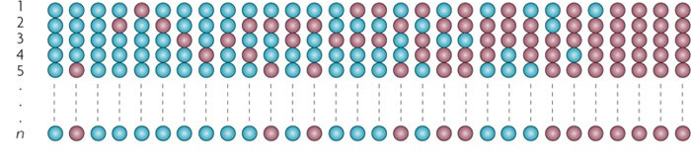
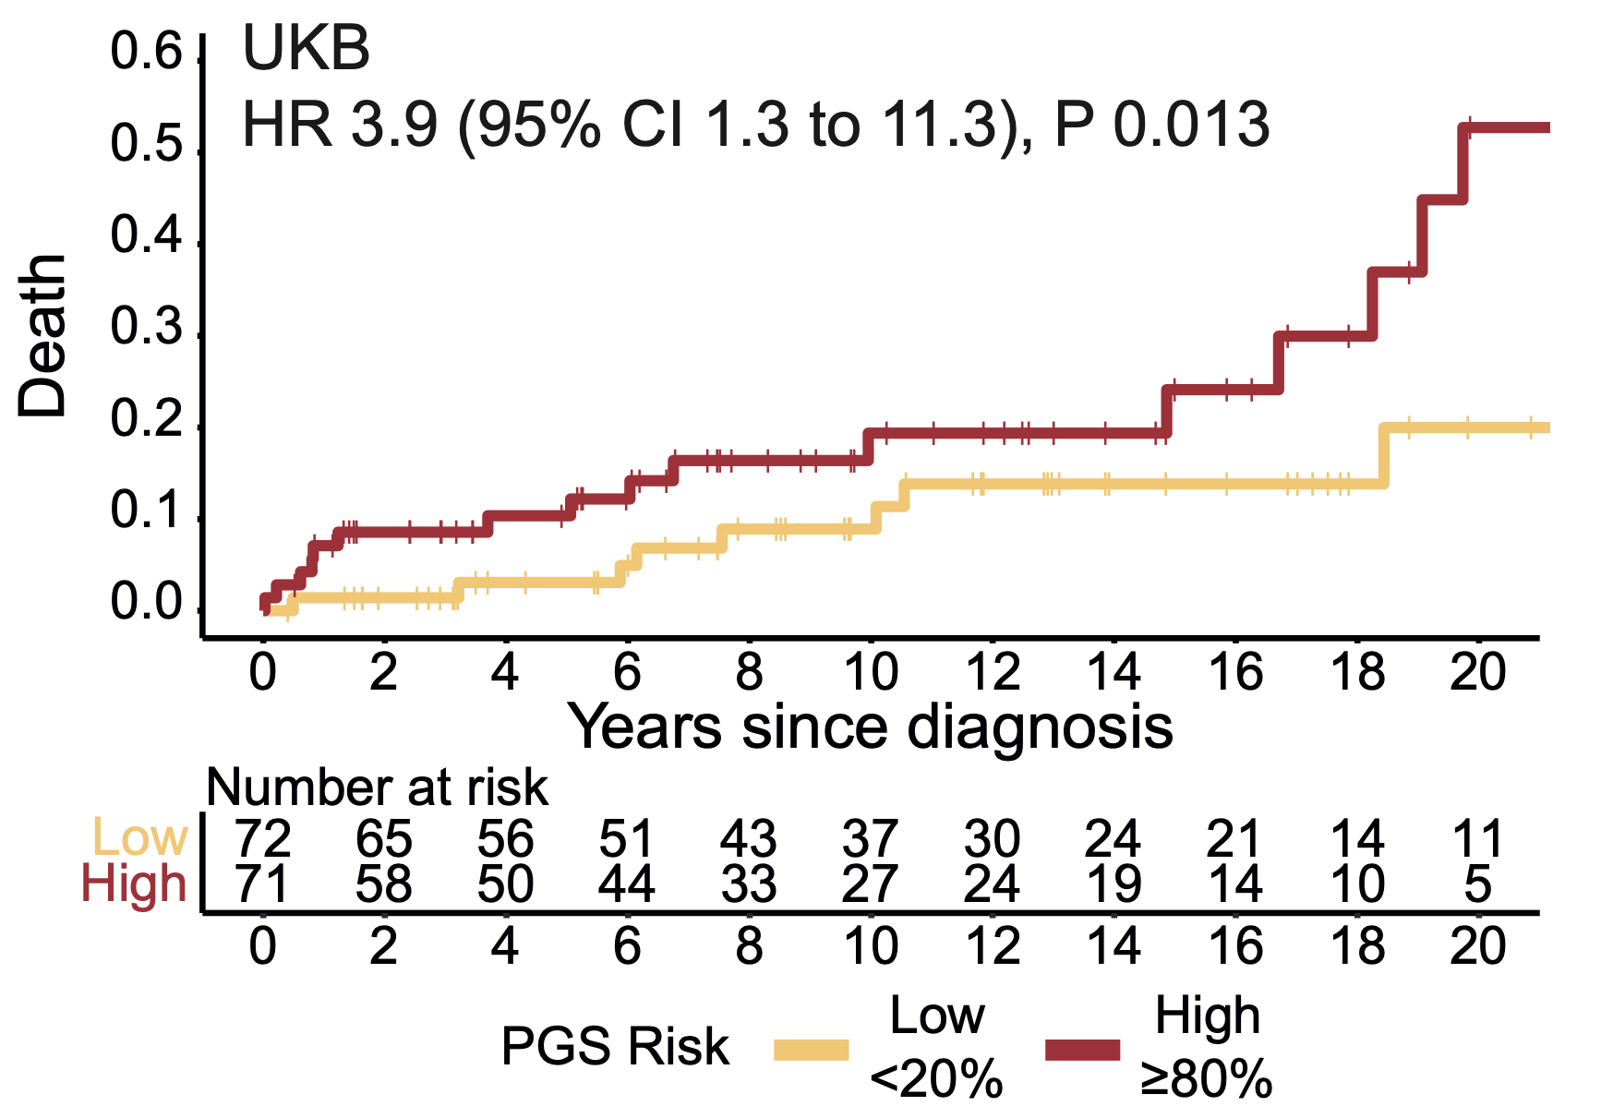
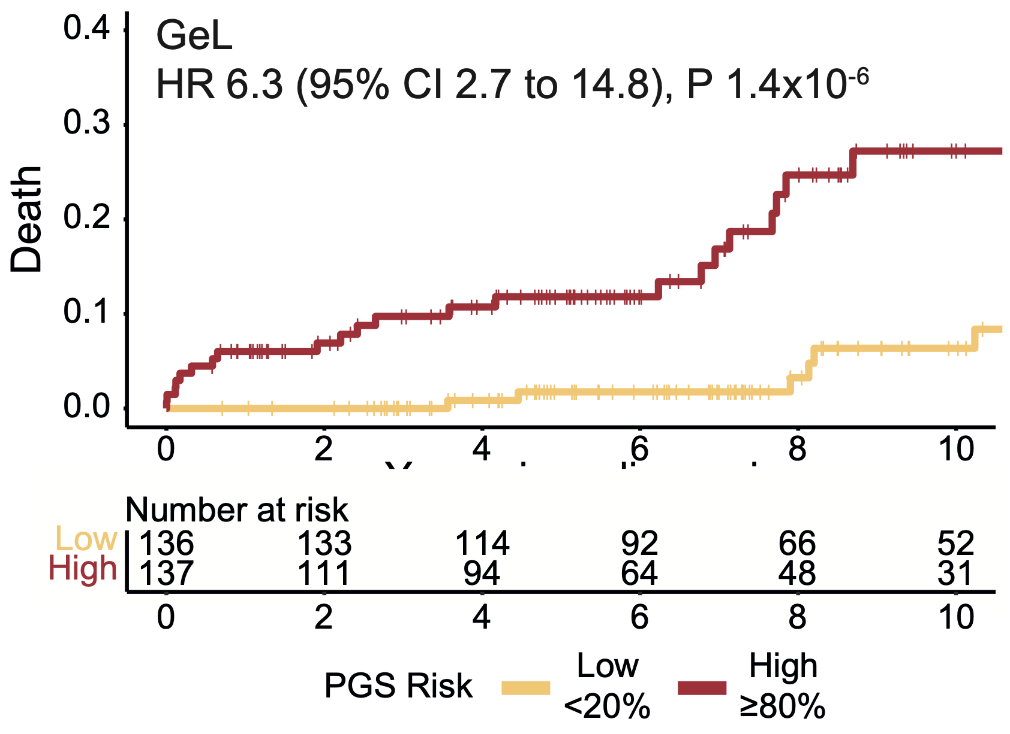
Genetic modifiers: polygenic risk scores
Genetic modifiers as risk modifiers in future?
variant
PRS_{HCM} = Σ [SNP X β]
Zheng et al. Nat Genet. 2025;57:563–571.

Slide 34
Take-home: evolving personalized phenotyping
NOW – risk factors for arrhythmic risk assessment
  Most left-sided NICM is ‘gene-elusive’ → phenotype is crucial!
  Gene-negative =/= low risk!
  Guideline risk assessment: LVEF, LGE (yes/no), ventricular ectopy, syncope, PES
  Periodically revisit phenotypic diagnosis and genetics!
SOON – move from risk factors to deeper phenotyping
  LGE important driver & more than yes/no: location and pattern/complexity matter!
  Additional phenotype details: active inflammation, RV, PVC burden, exercise ectopy?
  Combined quantitative risk models may be useful, but prospective validation needed
FUTURE – complex genetics and AI
  “Gene-negative” =/= genetically unexplained: PRS + intermediate effect variants?
  Multi-modal AI may capture even deeper phenotype: inform risk prediction?
Notes:
NOW — Phenotype drives risk assessment in gene-negative DCM/NDLVC
Gene-negative ≠ low risk: clinically important MVA risk persists despite absence of a P/LP variant.
Current guideline-based assessment integrates LVEF, LGE, NSVT/ventricular ectopy, unexplained syncope ± PES; significant LGE, NSVT and family history are particularly relevant in gene-negative NDLVC.
Revisit the diagnosis and the genetics: consider phenocopies/RV or ACM overlap, and periodically re-evaluate previously negative or uncertain genetic findings as gene–disease and variant evidence evolves. This fits particularly well with your slide showing the expansion in robust DCM genes.
NEXT — Move from individual risk factors towards deeper phenotyping
LGE is more than present/absent: extent, location and pattern/complexity appear to contain additional arrhythmic information, although these are not yet incorporated into guideline ICD algorithms.
Combined risk models integrating clinical, electrical and CMR characteristics may outperform individual markers, but prospective validation—and specifically validation in gene-negative DCM/NDLVC—is still needed.
Look beyond the LV: RV involvement and an overlapping/biventricular ACM phenotype may identify a different arrhythmic substrate and should prompt reassessment rather than simply being considered advanced DCM.
FUTURE — Genetics beyond rare P/LP variants
“Gene-negative” does not necessarily mean genetically unexplained: intermediate-effect variants and the cumulative contribution of common variants may account for part of the remaining susceptibility.
Polygenic risk and other genetic modifiers could eventually refine both disease penetrance and arrhythmic risk within conventionally gene-negative patients. Your Hernández → Zheng sequence makes this point naturally.
FUTURE — Multimodal prediction
The ultimate step is likely integration rather than another single marker: ECG/arrhythmia + imaging + clinical phenotype + genetics.
AI/multimodal models may capture interactions that conventional scores miss, but current DCM evidence is still preliminary and requires prospective, external validation before clinical implementation. Your DERIVATE-AI slide makes that limitation explicit.

Slide 35
Primary prevention in NICM: future?
Other genetic factors?
LVEF
35-49%
w/ OMT
LMNA P/LP variant
Induc. VT on PES
SCD/MVA stratification & ICD consideration
LVEF
<35%
w/ OMT
Other risk gene P/LP variant
LGE on cMR
Sucp. TLOC
Involved
RV?
NSVT, PVC burden
Family history SCD

Slide 36
Primary prevention in NICM: future?
Other genetic factors?
LVEF
35-49%
w/ OMT
LMNA P/LP variant
Induc. VT on PES
SCD/MVA stratification & ICD consideration
LVEF
<35%
w/ OMT
LGE pattern+
location
on cMR
Other risk gene P/LP variant
Sucp. TLOC
Involved
RV?
NSVT, PVC burden
Family history SCD

Slide 37
Thanks for your attention!

